Slide 1
Merge Sort
Lecture-3
Notes:
Mr. D. Clausen

Slide 2
Merge Sort?
The essential idea behind merge sort is to make repeated use of a function that merges two lists, each already in ascending order, into a third list, also arranged in ascending order.
The merge method itself only requires sequential access to the lists.
Its logic is similar to the method you would use if you were merging two sorted piles of index cards into a third pile.
That is, start with the first card from each pile.
Compare them to see which one comes first, transfer that one over to the third pile, and advance to the next card in that pile.
Repeat that comparison, transfer, and advance operations until one of the piles runs out of cards.
At that point, move what is left of the remaining pile over the the third merged pile.
‹#›
Notes:
Mr. D. Clausen

Slide 3
Merge Sort Recursive Outline
Merge sort employs a divide-and-conquer strategy to break the O(n²) barrier.
Here is an outline of the algorithm:
Compute the middle position of a vector and recursively sort its left and right subarrays (divide and conquer).
Merge the two sorted subarrays back into a single sorted array.
Stop the process when subarrays can no longer be subdivided.
This top-level design strategy can be implemented as three java functions:
MergeSort: the method called by clients (int main or control menu execution).
MergeSort: a helper method that hides the extra parameter required by recursive calls.
Merge: a helper method that implements the merging process.
‹#›
Notes:
Mr. D. Clausen

Slide 4
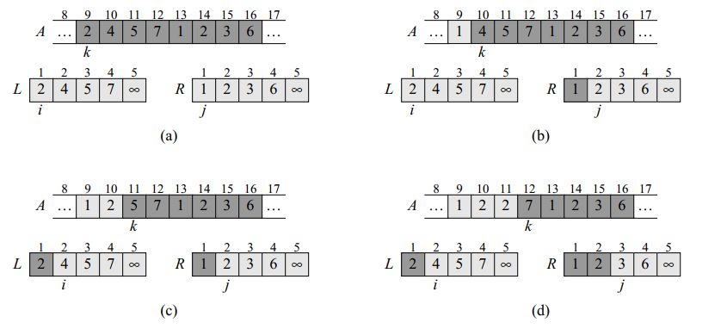
Merging
‹#›

Slide 5
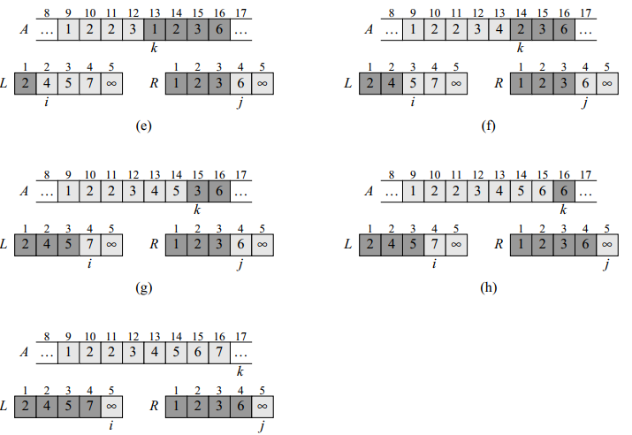
Merging….
Mr. Dave Clausen
‹#›

Slide 6
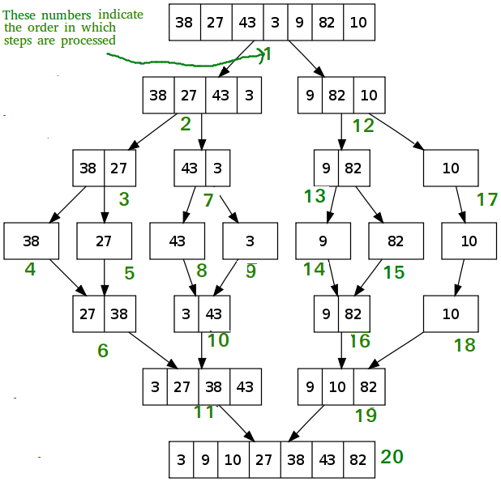
Merge Sort Walk Through
‹#›
Notes:
Mr. D. Clausen

Slide 7
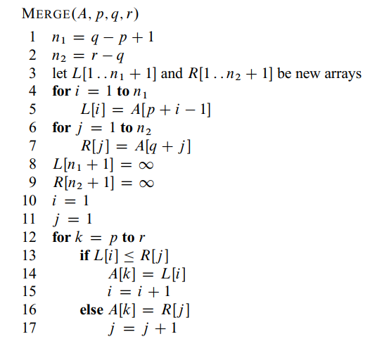
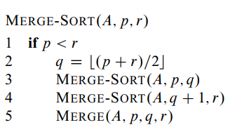
Merge sort algorithm
‹#›

Slide 8
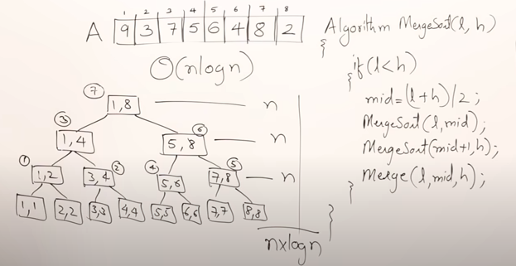
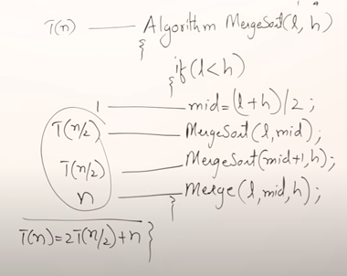
Complexity
‹#›

Slide 9
Merge Code Java
public void Merge(int A[], int p, int q, int r) {
write.Write("P="+p+" "+"Q="+q+" "+"R="+r+" "+"\n");
write.Write("Before Merge the array list is: ");
for(int l=1;l<A.length;l++)
{
write.Write(String.valueOf(A[l]));
}
write.Write("\n");
int i, j, k;
int L[] = new int[100];
int R[] = new int[100];
int n1 = q - p + 1;
int n2 = r - q;
for (i = 1; i <= n1; i++) {
L[i] = A[p + i - 1];
}
‹#›
Notes:
Mr. D. Clausen

Slide 10
Merge code Java
for (j = 1; j <= n2; j++) {
R[j] = A[q + j];
}
L[n1 + 1] = 1000000;
R[n2 + 1] = 1000000;
i = 1;
j = 1;
for (k = p; k <= r; k++) {
if (L[i] <= R[j]) {
A[k] = L[i];
i = i + 1;
} else {
A[k] = R[j];
j = j + 1;
}
}
write.Write("After Merge the array list is: ");
for(int l=1;l<A.length;l++)
{
write.Write(String.valueOf(A[l]));
}
write.Write("\n");
}
‹#›

Slide 11
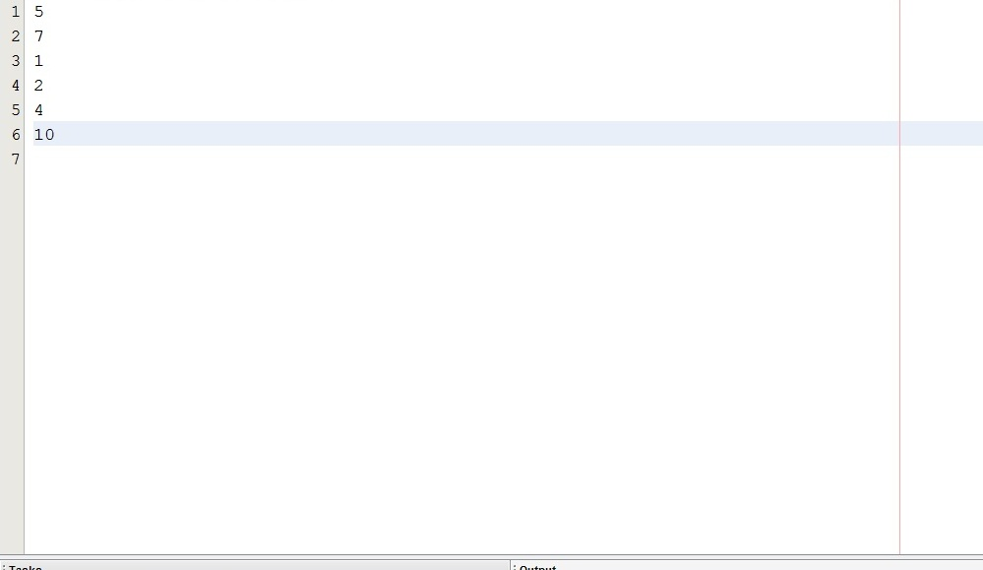
Here is sample Input of Merge sort
‹#›

Slide 12
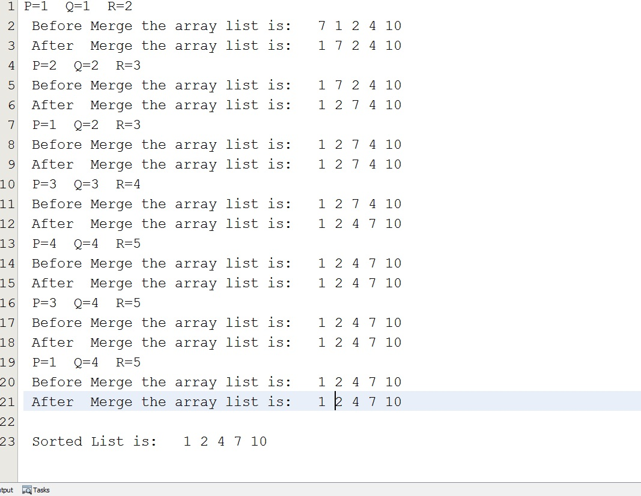
Here is sample output of Merge sort
‹#›

Slide 13
References
https://www.youtube.com/watch?v=mB5HXBb_HY8
https://www.geeksforgeeks.org/merge-sort/
Mr. Dave Clausen
‹#›

